Slide 1

*Welcome to Ashcroft Surgery*

Slide 2
Did you check in on your arrival?
If not, please do so now.
Either:
Go to reception or
Use the self checking in screen near the entrance

Slide 3
Have you seen our website?
www.ashcroftsurgery.co.uk
Book an appointment online
Request medication online
Details of all the services we offer (things you may not have known about)
Lots of good health information (a section for teenagers too)

Slide 4
Everyone here is equal
This practice doesn’t discriminate people based on things like their skin colour, culture, whether gay, straight, bi-sexual or trans, and so on.
And neither should YOU!
We hope our doctors and nurses help you feel comfortable enough should you want to talk about matters like sexuality.
And remember, what you say in the room, stays in the room!

Slide 5

Notes:
Catch it - sneezes

Slide 6
Coughs and Colds
If you are fit and generally well, most coughs and colds will settle by themselves.
You should see an improvement in 4 days and be back to near normal after 7 days (although the cough can take longer).
You often don’t need to see a GP as there is very little we can do other than to advise you to take paracetamol & drink plenty.
If the cough goes on beyond 2 weeks, is getting worse, or you have a lung condition like asthma, then by all means come in for a check over.

Slide 7
Antibiotics
Over 95% of coughs and colds are viruses.
So, if the doctor DOESN’T give you antibiotics for your chestiness, it’s because they think your infection is a virus.
Antibiotics are USELESS against viruses and their side effects can be worse than the virus itself.
Viruses usually die after 7 days anyway.

Slide 8
Notes:
Antibiotics

Slide 9
Antibiotics
Did you know that a week’s course of regular antibiotics only costs 21 pence?
So, if a doctor doesn’t give you antibiotics it’s NOT because they want to save money.
It’s because they don’t feel they will help and the side effects might make you worse.
Also, if we aren’t careful with the way we use antibiotics NOW, we will create superbugs that are difficult to destroy in the future (i.e. when your kids become adults and have kids of their own).

Slide 10

Help keep this place
clean and tidy.
This is YOUR surgery.
This is YOUR space.
It is for YOUR community.
Please look after it and treat it kindly.

Slide 11
Would you like to talk over the phone?
Is it possible that your reason for coming today can be dealt with over the phone?
Some things, like a medication review, sick note, simple minor illnesses (coughs/colds) can be dealt with over the phone.
Because you’re not waiting around in the surgery, telephone consultations help you carry on with other things in your life.
Simply ask the receptionist if a telephone consultation is advisable.

Slide 12

Notes:
8 ways to change your life

Slide 13
Patients who don’t turn up
Please let us know in good time if you are unable make your appointment – the earlier you ring, the better. We can then offer it to someone else in need.
Did you know that we have roughly 300 appointments EVERY MONTH where patients don’t turn up?
That’s why it is sometimes hard for us to offer you an appointment when you want it.
But this month has been better! So a big THANK YOU to those of you have rung to cancel.

Slide 14
Patients who don’t turn up
Roughly 300 patients don’t turn up every month.
That’s 3600 appointments wasted every year.
That’s 200 extra surgeries!
So - please let us know in good time if you are unable make your appointment – the earlier, the better.
Help us to offer it to someone else who is in need.

Slide 15
Notes:
Alcohol

Slide 16
Have you been kept waiting long?
If you have been waiting in the surgery for a while, we are deeply sorry.
Often, doctors and nurses over run because they’re trying to help patients with complex lives and complex problems.
We would like to thank you for your patience.

Slide 17

Notes:
Chlamydia

Slide 18
Be nice…
Please be nice to our staff. We will remove patients from our list who are aggressive – even verbally. Help us not to have to resort to this.
We come to work with a positive attitude because we like helping people.
So please don’t treat us with disrespect – it ruins our day, it ruins your day and it devalues our work.
If you’re upset by something, please take a deep breath, calm yourself down and then speak to us. We will try our best to help you.

Slide 19
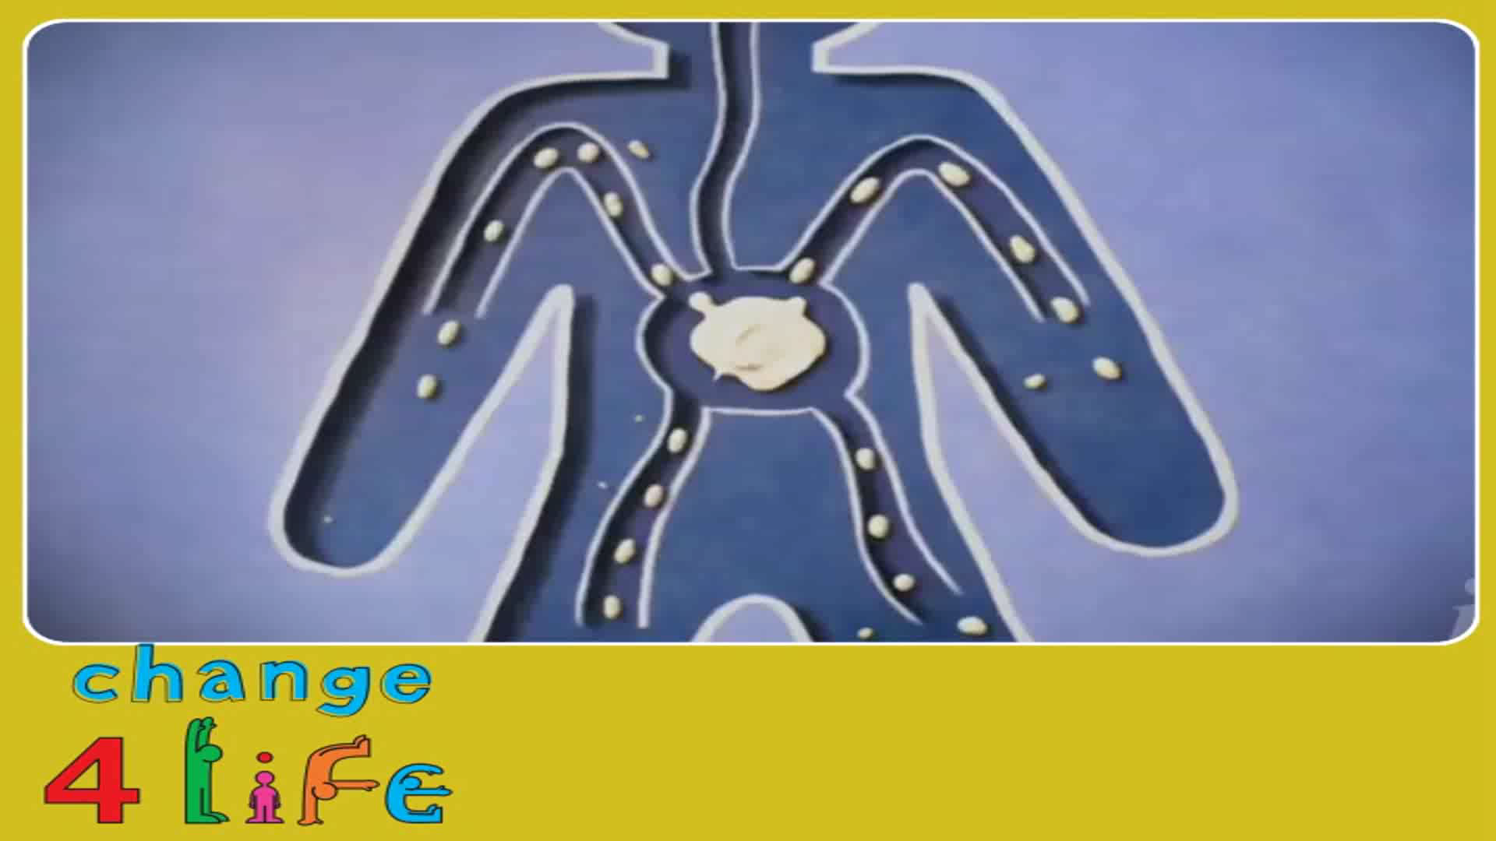
Notes:
Kids and diet

Slide 20
www.ashcroftsurgery.co.uk
Visit our website where you can
Book appointments online
Order medication online
Read about all the services we offer
Find lot’s of really good health information
Read about our staff

Slide 21
Notes:
Carers

Slide 22
The Call 1 1 1 Service
This surgery is usually closed from 6pm until 8am.
We are also closed on weekends and bank holidays.
HOWEVER, if you need to see or speak to a doctor during these times (and it can’t wait until the next working day), there is something called the Call 111 Service. Simply dial 1 1 1 from your phone.

Slide 23
The Call 1 1 1 Service
If you have a problem which is not an emergency or you are unsure as to whether it is, the call 111 service will help you.
You can also call them if you want some health advice about something – even if it is not urgent.
Please try not go to Accident & Emergency unless you are involved in a bad accident or emergency.

Slide 24
The A & E Department
We all know how busy the Accident & Emergency department of Bradford Royal Infirmary is.
They do a tremendous job in helping people involved in serious accidents and life-threatening emergencies.
However, they seem to be seeing a lot of patients who should not be there - many of them belong to this surgery. The problem is that this delays them from seeing patients who are in a bad way.

Slide 25
The A & E Department
Please, think twice before you ring 999 or go to A&E.
If you’re in a bad way – by all means, go there.
But if you’re problem is less urgent, please think about calling 111 for urgent advice or ring/come to us.
The call 111 service is open 24 hours a day. The surgery is open from 8.30am until 6pm.

Slide 26
Your options when Surgery is Open
Before calling us, try calling 111. They give excellent health advice and will put you in touch with a doctor if they feel you need to see one.
Call any time - it’s open 24 hours a day!
Of course, you can ring us to speak to a doctor/nurse OR look on our website: www.ashcroftsurgery.co.uk - click on ‘health information’.
If your condition is urgent, you can go to A&E. But if you are unsure, call 111 or ring/come to us first.

Slide 27
Your options when Surgery is Closed
Again, think about calling 111 to get excellent health advice or see a doctor.
They are open 24 hours a day
Think about using our website – where there is lots of health information and advice. Go to www.ashcroftsurgery.co.uk and click on ‘Health Information’.
And if your condition is urgent, you can go to A&E but think about whether you might want to call 111 first.

Slide 28
Notes:
5 a day

Slide 29
Have you been kept waiting?
If you have been waiting for over 45 minutes:
1. Did you check in upon your arrival?
2. Ask a receptionist whether you are definitely on the list.
Please note:
It is not unusual to be kept waiting for up to 1 hour if you have requested to be seen in the urgent appointment surgery. The doctor is most likely busy dealing with other patients who have asked to be seen urgently too. Thank you for being patient.

Slide 30

Notes:
Dementia

Slide 31
Repeat Prescriptions & Medication
If you’re on regular medicines and need more, bring in the repeat list attached to the prescription - tick only items required.
If you don’t have the repeat list, then write the medicine required in CAPITALS with your full name and address.
Allow 2 work days for your prescription. To reduce the pressure on our system, please do not ring or come in before then.
Please don’t order too early or anything you don’t need. And if your medicine runs out at different times, ask your doctor to see if they can fix this the next time you see them.

Slide 32
Notes:
Medicines wastage

Slide 33
Home Visits
Home visits are for patients who are bed bound.
They are not for patients who simply have no transport. Try talking to a neighbour or friend with a car or catch the bus.
If you need a home visit, PLEASE call the surgery BEFORE 11am, so that the Doctor can plan his/her day.
But do try to come to the surgery - we can see you quicker and we have all the right equipment here.

Slide 34
Home Visits
You may be surprised to hear about the number of patients who request a home visit because they won’t get a bus or taxi or even walk!
☺ Please try to come to the surgery ☺
Talk to a relative, friend or neighbour with a car.

Slide 35

Notes:
Lifestyle

Slide 36
Telephone appointments
These appointments are available to all patients who are unable or feel it unnecessary to attend the surgery but require simple advice without examination.
Please request a telephone appointment. The GP or nurse will phone you back within a given time scale.

Slide 37

Notes:
What shape are you in?

Slide 38

Notes:
Travel Advice

Slide 39
Travel injections
Most vaccinations need to be done well in advance of departure, so PLEASE plan ahead.
Don’t leave everything until the last minute because we may not be able to squeeze you in.
Travel injections are given by the nurse and there is a fee associated with them.
If you are planning to go abroad, please ring the surgery and ask for a travel advice appointment with the nurse at least 6 weeks before your departure date.

Slide 40
Notes:
Home Heat Helpline

Slide 41

Notes:
Bowel Cancer

Slide 42

Notes:
Swim 4 Life

